Slide 1
Data and Decisions
06N:216
Displaying Data

Slide 2
Sources
Edward R. Tufte, “The Visual Display of Quantitative Information,” 2nd ed., Graphics Press, Cheshire, CT (2001)
http://www.edwardtufte.com

Slide 3
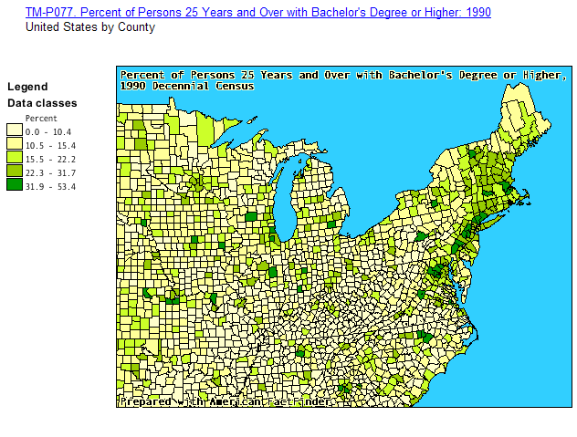
Data Maps

Slide 4
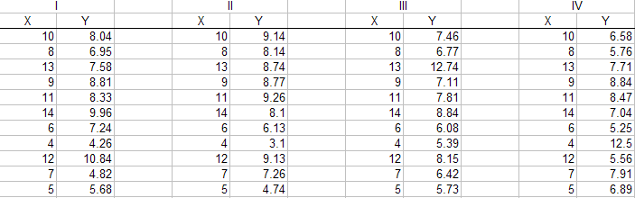
Power of Data Display
4 data sets, N = 11
All described by the same linear regression model: same equation of the line, same r², same correlation coefficient
In other words, statistically the same

Slide 5




Power of Data Display
→ Motivates graphical display of residuals in regression models

Slide 6
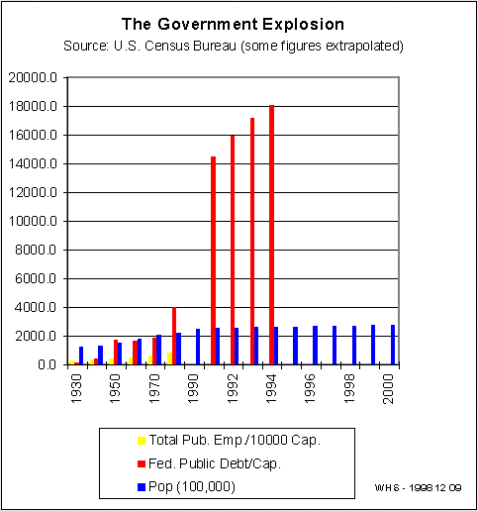
Pitfalls of Data Display
Inconsistent units
  A 1930 dollar is worth far more than a 1994 dollar
Irregular scale
  The x-axis scale begins by incrementing by 20 years and switches by 2 year increments
From: http://www.fathersforlife.org/happydgx.htm

Slide 7
Elements of Good Graphical Display
Show the data
Show substance rather than methodology, graphic design, technology
Avoid distortion
Make large data sets coherent
Encourage visual comparison
Serve a clear purpose
Be closely associated with statistical and verbal descriptions of data set

Slide 8
Useful Tips for Better Display, Especially in Excel
Reduce Data-ink Ratio

Slide 9
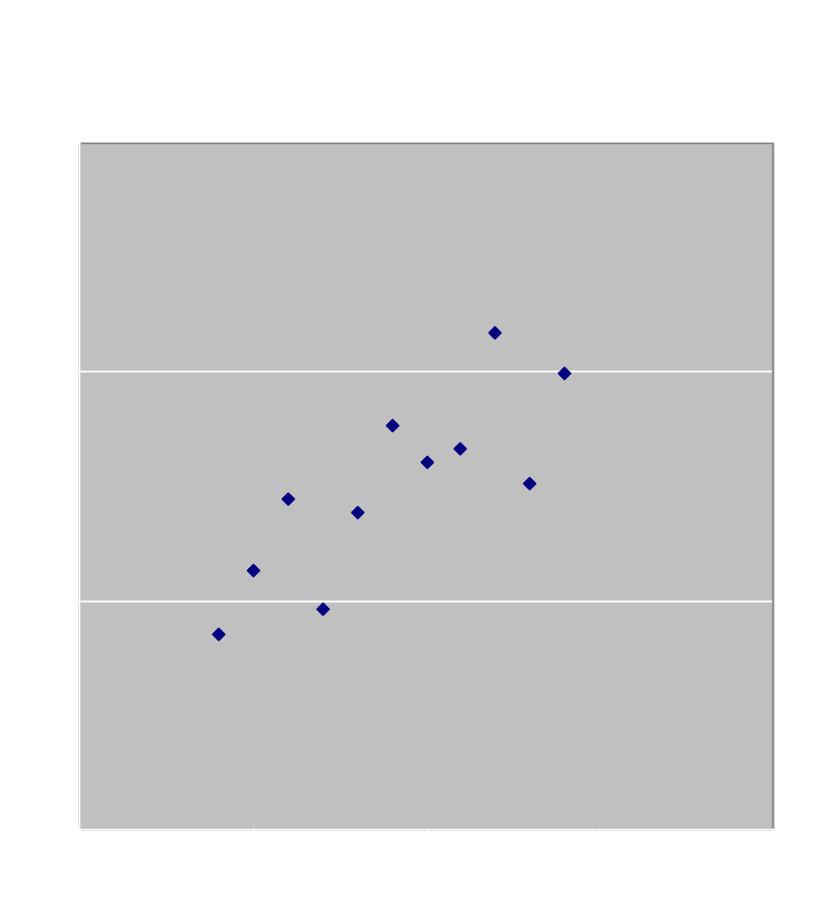
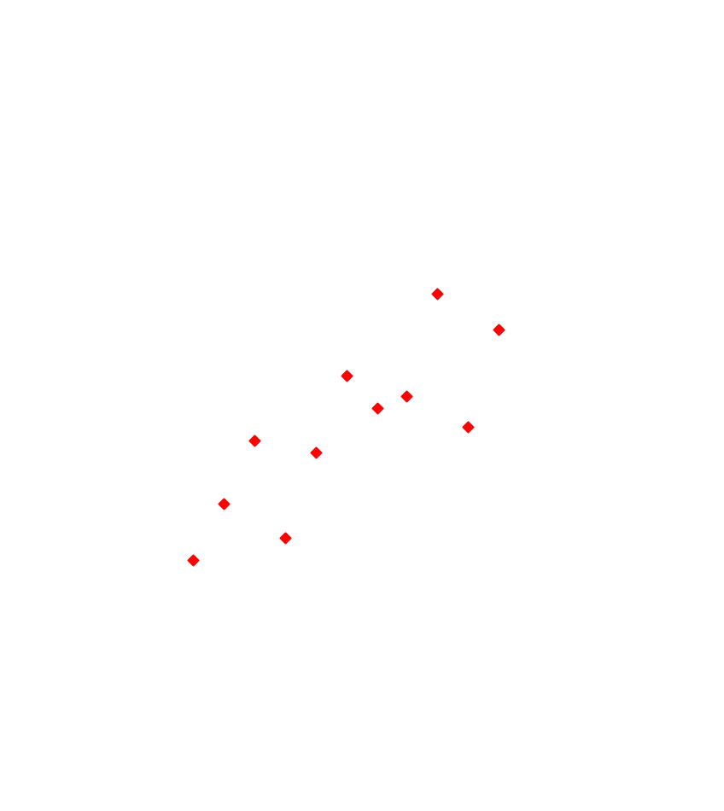
Data-Ink Ratio

Slide 10
Useful Tips for Better Display, Especially in Excel
Reduce Data-ink Ratio
Avoid Moiré effects

Slide 11

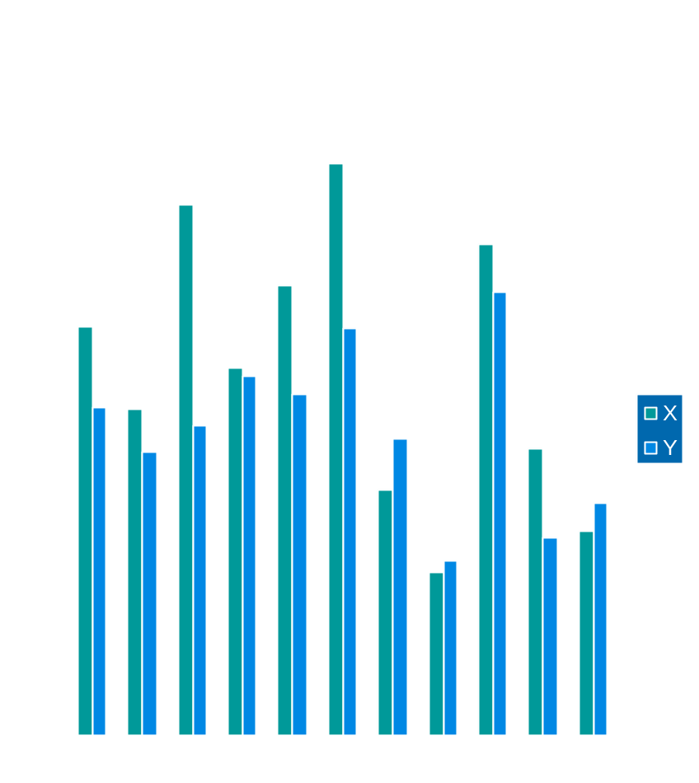
Moiré Effects

Slide 12
Useful Tips for Better Display, Especially in Excel
Reduce data-ink ratio
Avoid Moiré effects
Avoid fake perspective

Slide 13
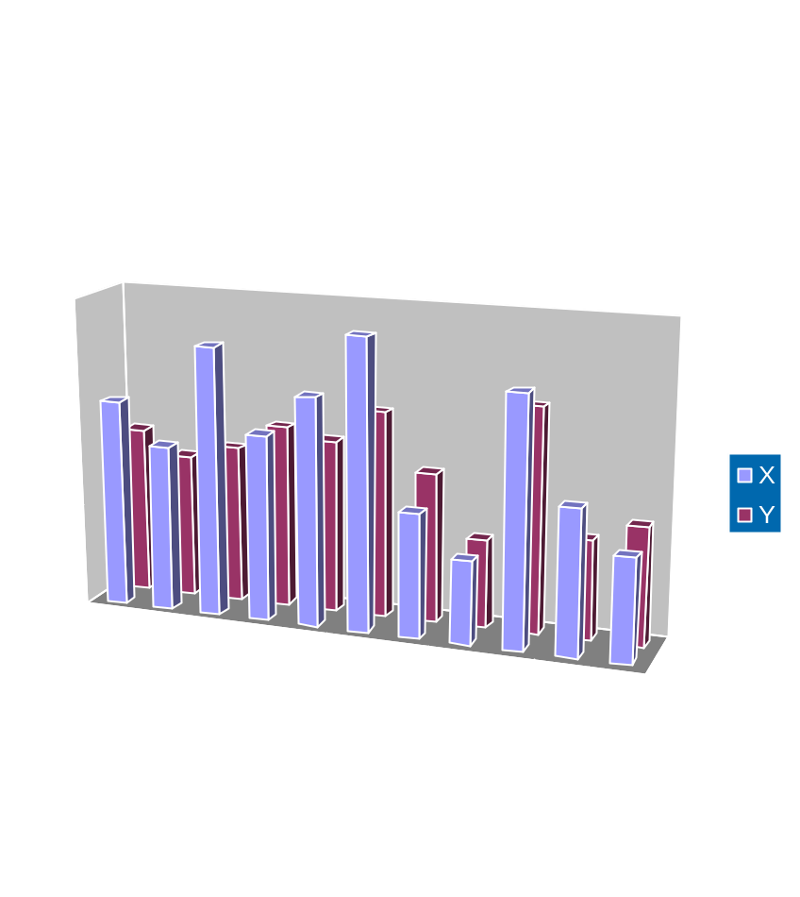
Depth Effects

Slide 14
